Slide 1
License Review Process, Open Source Community And Development Process
Shahina Anwarul
sanwarul@ddn.upes.ac.in

Slide 2
The License Review Process
The goal of the OSI License Review Process is to ensure that licenses and software labeled as "open source" conforms to existing community norms and expectations.
For that reason, all licenses must go through a public review process.

Slide 3
Purpose Of The Process
Ensure approved licenses conform to the Open Source Definition
Identify appropriate License Proliferation Category
Avoid duplicate Licenses
Ensure a thorough, transparent and timely review (e.g. within 60 days)

Slide 4
Categories Of Licenses According To OSI
Licenses that are popular and widely used or with strong communities
We used statistics obtained from public sources to determine which licenses are widely used. We believed that there were a few licenses that, while not the most popular, were widely used within their communities and that these also belonged in this group.
Special purpose licenses
Certain licensors, such as schools and the US government, have specialized concerns, such as specialized rules for government copyrights. Licenses that were identified as meeting a special need were placed in this group.
Licenses that are redundant with more popular licenses
The committee struggled with this group, but ultimately decided that if we were to attack the license proliferation problem, we had to prune licenses. Thus, licenses that were perceived as completely or partially redundant with existing licenses were placed in this group.

Slide 5
Categories Of Licenses According To OSI
Non-reusable licenses
Licenses in this group are specific to their authors and cannot be reused by others.
Superseded licenses
Licenses in this category have been superseded by newer versions.
Licenses that have been voluntarily retired
No one should use these licenses going forward, although we assume that licensors may or may not choose to continue to use them.
Other/Miscellaneous licenses
These licenses do not fall neatly into any category.

Slide 6
Examples Of Licenses According To Their Category
Licenses that are popular and widely used or with strong communities
Apache License, 2.0
New BSD license
GNU General Public License
GNU Library or "Lesser" General Public License (LGPL version 2)
MIT license
Mozilla Public License 1.1 (MPL)
Special purpose licenses
Educational License
License used in NASA
Superseded licenses
Apache License, 1.0
Mozilla Public License, 1.0
Mozilla Public License, 1.1

Slide 7
Examples Of Licenses According To Their Category
Licenses that are redundant with more popular licenses
Academic Free License (redundant with Apache 2.0)
Attribution Assurance Licenses (redundant with BSD)
University of Illinois/NCSA Open Source License (redundant with BSD)
X.Net License (redundant with MIT)
Non-reusable licenses
Apple Public Source License
IBM Public License
PHP License
Python license
Nokia Open Source License
Other/Miscellaneous licenses
Adaptive Public License
Artistic License

Slide 8
What Does License Proliferation Mean?
License proliferation refers to the phenomena of an abundance of already existing and the continued creation of new software licenses for software packages in the FOSS (Free Open Source Software) ecosystem.

Slide 9
How To Submit A License
Submit the license to the Open Definition forum for discussion. For a new license, this should occur before the license is finalized, so that you can revise based on the group’s feedback.
To do this:
Sign up to the forum, so that you can participate in the discussion.
Send all of the following information to the forum:
Link to the full text of the license. If the license is not in English, also provide a translation to English.
State the rationale for the new license.

Slide 10
How To Submit A License
Explain whether the license may be used by any licensor, or is specific to an organization/place/jurisdiction (e.g., the organization is a national government; and these are categorized as “non-reusable”).
Compare and contrast to the most similar approved Open definition conformant licenses.
Explain the benefit of the new license brings over already approved OD-conformant licenses.

Slide 11
How To Submit A License
Identify the compatibility of the new license with other OD-conformant licenses.
Identify the type of submission (Retirement, Legacy Approval or Approval)
Subscribe to license-review (if you aren't already)
Submit a formal request to license-review.
The request email must include:
the submission type and license name in subject field (to ensure proper tracking)
a plaintext copy of the license
the supporting data listed below (as appropriate for the type of submission)

Slide 12
Submission Types And Supporting Data
For Approval
Approval of completely new licenses, or licenses previously used by an entity
Rationale: Clearly state rationale for a new license
Distinguish: Compare to and contrast with the most similar OSI-approved license(s)
Legal review: Describe any legal review the license has been through, and provide results of any legal analysis if available
Proliferation category: Recommend which license proliferation category is appropriate

Slide 13
Submission Types And Supporting Data
For Retirement
A request to retire the license. Note that successor licenses must be approved through the new license approval process.
Version: Specify exactly which version is being retired.
Successor: Identify successor license(s), if any.

Slide 14
Submission Types And Supporting Data
For Legacy Approval
Approval of historic/legacy licenses that have already been extensively used by an existing community, but have not previously been approved.
Rationale: Describe the nature and history of the existing usage.
Proliferation category: Recommend which license proliferation category is appropriate

Slide 15
What Will Happen
The License Review community will discuss on the mailing list for at least 30 days. The submitter should participate in this discussion by replying to any questions asked or claims made about the license.
The License Review Chair will summarize and present recommendations to OSI Board (and copy the list).
The OSI Board will make the final decision, or requests for additional information, at the next monthly meeting.
The License Review Chair will report back to the List.
If Approved, the OSI Website will be updated as appropriate.

Slide 16
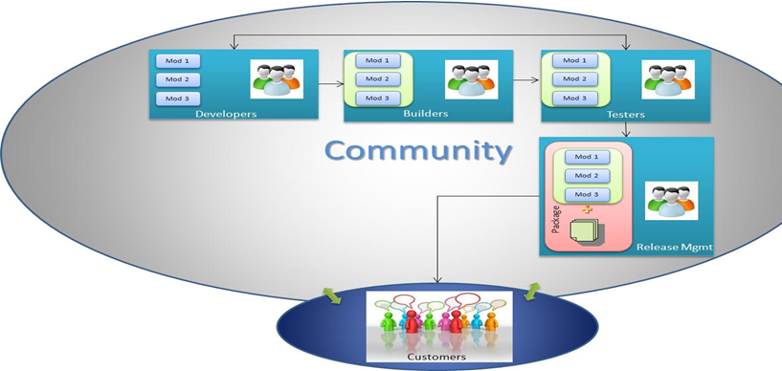
Open Source Community

Slide 17
Open Source Community
Developers: They are responsible for coding of different modules of the open source software.
Builders: They work on these modules to build a new version of the software.
Testers: They take the software build and test the software functionality. In case of a failure they report back to the developers.
Release Management: They package the final version of the software along with necessary documents.

Slide 18
Open Source Development Process
It is the process by which open-source software, or similar software whose source code is publicly available is developed.
Call for contribution-By Richard Stallman
“Starting this Thanksgiving I am going to write a complete Unix-compatible software system called GNU (Gnu's Not Unix), and give it away free to everyone who can use it. Contributions of time, money, programs and equipment are greatly needed.” Richard Stallman wrote this above message which was displayed to user who logged into Usenet newsgroup.

Slide 19
Open Source Software Development Process Model
Open-source software development can be divided into several phases.
In the given process flow model, the phases of open-source software development are displayed, along with the corresponding data elements.

Slide 20
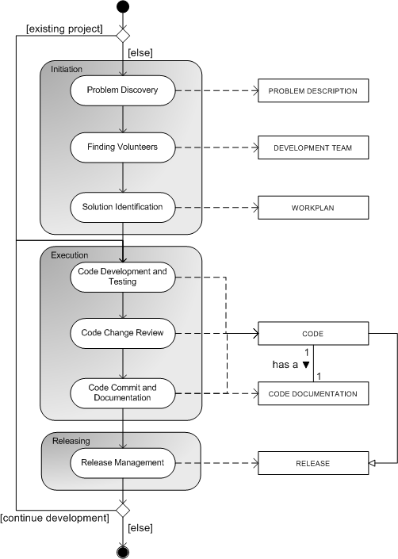

Slide 21
Open Source Development Process
There are several ways in which work on an open-source project can start:
An individual who senses the need for a project announces the intent to develop a project in public.
A developer working on a limited but working codebase, releases it to the public as the first version of an open-source program.
The source code of a mature project is released to the public.
A well-established open-source project can be forked by an interested outside party.

Slide 22
Myth Buster
Myth #1: Open Source is unreliable.
Myth #2: Open Source software are not well supported.
Myth #3: Open source is highly insecure, and also bulletproof.
https://www.universitybusiness.com/article/open-source-myth-busters

Slide 23
Myth Buster
Eric S. Raymond the author of “Cathedral and the Bazaar” pointed 2 kinds of software development. The first is like building a cathedral, with complete planning from start to finish this was followed in closed source development. The second is like the model of bazaar. Anyone can buy and sell the things in the market. Eric also observed in one of the conference delivered by Richard Stallman and Linux Torvalds, where Torvalds had found a way around Brook’s Law.
CatB is an essay, and later a book, by Eric S. Raymond on software engineering methods, based on his observations of the Linux kernel development process and his experiences managing an open source project, fetchmail.

Slide 24
Brook’s Law:
Brooks' law is a claim about software project management according to which "adding manpower to a late software project makes it later". It was coined by Fred Brooks in his 1975 book The Mythical Man-Month.
According to Brooks, there is an incremental person who, when added to a project, makes it take more, not less time.

Slide 25
Brook’s Law:
Brooks points to the main factors that explain why it works this way:
It takes some time for the people added to a project to become productive. Brooks calls this the "ramp up" time.
Software projects are complex engineering endeavors, and new workers on the project must first become educated about the work that has preceded them; this education requires diverting resources already working on the project, temporarily diminishing their productivity while the new workers are not yet contributing meaningfully.
Each new worker also needs to integrate with a team composed of several engineers who must educate the new worker in their area of expertise in the code base, day by day.

Slide 26
Brook’s Law
In addition to reducing the contribution of experienced workers (because of the need to train), new workers may even make negative contributions, for example, if they introduce bugs that move the project farther from completion.
Communication overheads increase as the number of people increases. Everyone working on the same task needs to keep in synchronized, so as more people are added they spend more time trying to find out what everyone else is doing.

Slide 27
Exceptions and possible solutions
Brooks' law is often cited to justify why projects keep being late, despite management efforts. However, there are some key points in Brook's law that allow exceptions and open the door for possible solutions.
Projects can be brought back into (or kept in) control if people are added earlier in the process
Correcting the schedule is the best way to have a meaningful and reliable time frame for the project's completion.
The quantity, quality and role of the people added to the project also must be taken into consideration.

Slide 28
Exceptions and possible solutions
Good programmers or specialists can be added with less overhead for training.
People can be added to do other tasks related with the project, for example, quality assurance or documentation; given that the task is clear, ramp up time is minimized.
Good management and development practices also help to minimize the impact of Brooks' law.
New tools for software development and documentation also help to minimize the ramp up time, making it simpler for new programmers to get involved in the work.
Design patterns simplify the distribution of work.

